Slide 1
MAHI MISTRY MENTOR – Mr. MUNNA PANDEY
DATA - DRIVEN ANALYTICS PROJECT
PART I & II

Slide 2

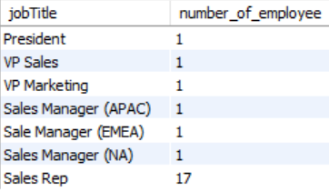
Employee Data Analysis Q1) Find the total number of employees. (Task 1)
Query: select count(employeeNumber) as total_employee from employees;
Interpretation: This value will show the total number of employees
Q2) Count the number of employees holding each job title. (Task 1)
Query: select jobTitle, count(employeeNumber) as number_of_employee
from employee
group by jobTitle
order by number_of_employee;
Interpretation: This table values will show the count of number employees working in job title

Slide 3
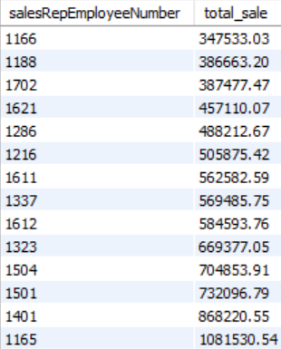
Q3) Calculate total sale generated by each sales representative. (Task 1)
Query: select salesRepEmployeeNumber, sum(quantityOrdered*priceEach) as total_sale from customers
join orders using (customerNumber)
join orderdetails using (orderNumber)
group by salesRepEmployeeNumber
order by total_sale;
Interpretation: This value will show the total sales generated by each sale representative with the help of representative Employee number

Slide 4
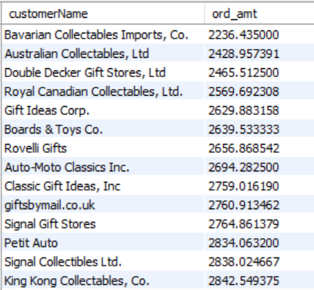
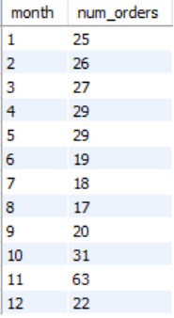
Q4) Find the average order amount for each customer (Task 2)
Query: customerName,
avg(priceEach*quantityOrdered) as ord_amt
from customers
join orders using(customerNumber)
join orderdetails using (orderNumber)
group by customerName
order by ord_amt;
Interpretation: This column values will show the average order amount for each customer with there name
Q5) Find the number of order placed in each month (Task 2)
Query: select month(orderDate) as month,
count(*) as num_orders
from orders
group by month(orderDate);
Interpretation: This shows the number of order placed in each month

Slide 5
Q6) List all orders with their corresponding order details. (Task 2)
Query: Select orderNumber, orderDate, productName, productDescription, status, quantityOrdered,
priceEach from orders join orderdetails using (orderNumber)
join products using (productCode);
Interpretation: This all column will show’s you the details of all orders with their corresponding order details.
orderNo | orderDate | productName | productDescription | status | quantity | price
10100 | 2003-01-06 | 1917 Grand Touring Sedan | This 1:18 scale replica of the 1917 Grand Touring car has all the features you would expect from museum quality reproductions: all four doors and bi-fold hood opening, detailed engine and instrument panel, chrome-look trim, and tufted upholstery, all top... | Shipped | 30 | 136.00
10100 | 2003-01-06 | 1911 Ford Town Car | Features opening hood, opening doors, opening trunk, wide white wall tires, front door arm rests, working steering system. | Shipped | 50 | 55.09
10100 | 2003-01-06 | 1932 Alfa Romeo 8C2300 Spider Sport | This 1:18 scale precision die cast replica features the 6 front headlights of the original, plus a detailed version of the 142 horsepower straight 8 engine, dual spares and their famous comprehensive dashboard. Color black. | Shipped | 22 | 75.46
10100 | 2003-01-06 | 1936 Mercedes Benz 500k Roadster | This model features grille-mounted chrome horn, lift-up louvered hood, fold-down rumble seat, working steering system and rubber wheels. Color black. | Shipped | 49 | 35.29
10101 | 2003-01-09 | 1932 Model A Ford J-Coupe | This model features grille-mounted chrome horn, lift-up louvered hood, fold-down rumble seat, working steering system, chrome-covered spare, opening doors, detailed and wired engine | Shipped | 25 | 108.06
10101 | 2003-01-09 | 1928 Mercedes-Benz SSK | This 1:18 replica features grille-mounted chrome horn, lift-up louvered hood, fold-down rumble seat, working steering system, chrome-covered spare, opening doors, detailed and wired engine. Color black. | Shipped | 26 | 167.06

Slide 6
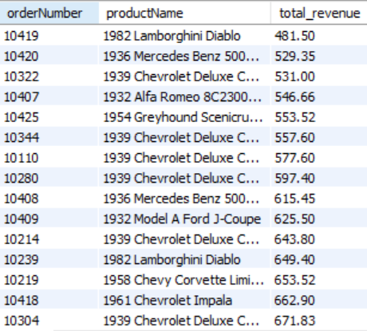
Q7) Calculate total revenue for each order. (Task 2)
Query:
select orderNumber, productName,
sum(quantityOrdered * priceEach)
as total_revenue
from orders
join orderdetails using (orderNumber)
join products using (productCode)
group by orderNumber, productName
order by total_revenue;
Interpretation: This table will show the total revenue for each order

Slide 7
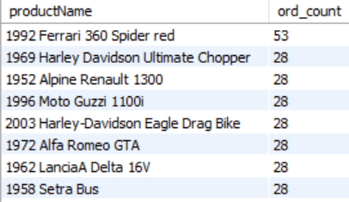
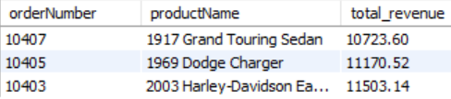
Q8) List the most frequently ordered products. (Task 2)
Query: select productName,
count(*) as ord_count from products
join orderdetails using(productCode)
group by productCode
order by ord_count desc;
Interpretation: This table value shows the most frequently ordered products.
Q9) Identify the most profitable orders based on total revenue. (Task 2)
Query: select orderNumber, productName,
sum(quantityOrdered * priceEach)
as total_revenue from orders
join orderdetails using (orderNumber)
join products using (productCode)
group by orderNumber, productName
order by total_revenue desc
limit 3;
Interpretation : This show the most profitable order based on total revenue

Slide 8
Q10) Identify orders with delayed shipping (shippedDate > requiredDate) (Task 2)
Query: select * from orders
where shippedDate > requireddate;
Interpretation : This table value will show you all the order which are delayed shipping on required date

Slide 9

Q11) Create a trigger that logs product quantity changes whenever an order detail is inserted or updated. (Task 2)
DELIMITER //
CREATE TABLE product_quantity (
log_id INT PRIMARY KEY AUTO_INCREMENT,
productCode INT NOT NULL,
old_quantity INT,
new_quantity INT,
change_date TIMESTAMP DEFAULT CURRENT_TIMESTAMP);
CREATE TRIGGER after_order_items_insert_update
AFTER INSERT ON orderdetails
FOR EACH ROW
BEGIN
INSERT INTO product_quantity (productCode, old_quantity, new_quantity)
VALUES (90, 46, 98);
END //
DELIMITER ;
select * from product_quantity;
Interpretation: This show the values inserted in created trigger that logs product quantity changes whenever an order detail is inserted or updated.

Slide 10
CONLUSION:
Task 1: Employee and Sales Analysis
The analysis focuses on understanding the employee structure and their performance within the organization.
provides an overview of the total number of employees, basic employee details, and identifies employees without managers.
Additionally, the analysis identifying the most profitable one, and highlighting those who exceed the average sales in their respective offices.
Task 2: Order and Customer Analysis
The second task delves into customer orders and their implications for the business.
It includes a detailed breakdown of average order amounts, monthly order volumes, and specific order statuses such as pending shipments.
The analysis also highlights the most recent and highest value orders, along with total sales and revenues associated with each order.
This analysis helps the business in understanding customer behaviour, optimizing order processing, and enhancing overall revenue management.

Slide 11
THANK YOU

